Slide 1
Quill Home Page Testing
Concept Design Testing
Feedback and Recommendations
Prepared by: Jim Hall & Steve Mings

Slide 2
Goals and Methodology
12 Contextual Interviews were conducted with local Quill customers.
The customer were asked to give open and honest feedback on all aspects of Quill.
New Homepage design look and feel, ease of use
New type ahead interaction
Homepage compared to current production
New lists design look and feel, ease of use
Punchcard ideas, perhaps you currently participate in other programs what would this kind of program look like for Quill

Slide 3
High Level Summary
All users preferred new homepage design look and feel, type ahead interaction, and new lists design.
4/12 had difficulty finding the search bar
8/12 of users mentioned using search or reorder to purchase items rather than browsing site
8/12 said favorable things about punchcards

Slide 4
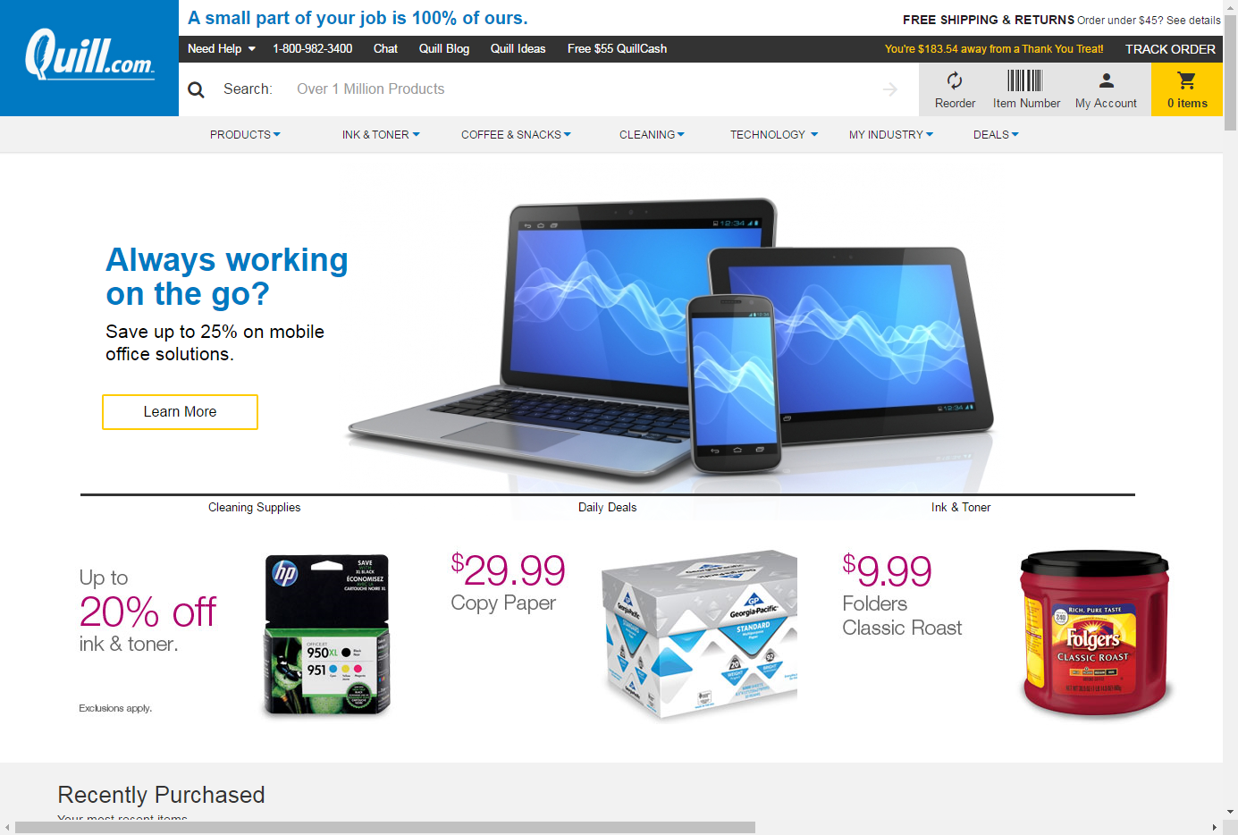

Slide 5
Findings – Homepage
Findings – Homepage
8/12 users reported only using search and reorder

Slide 6
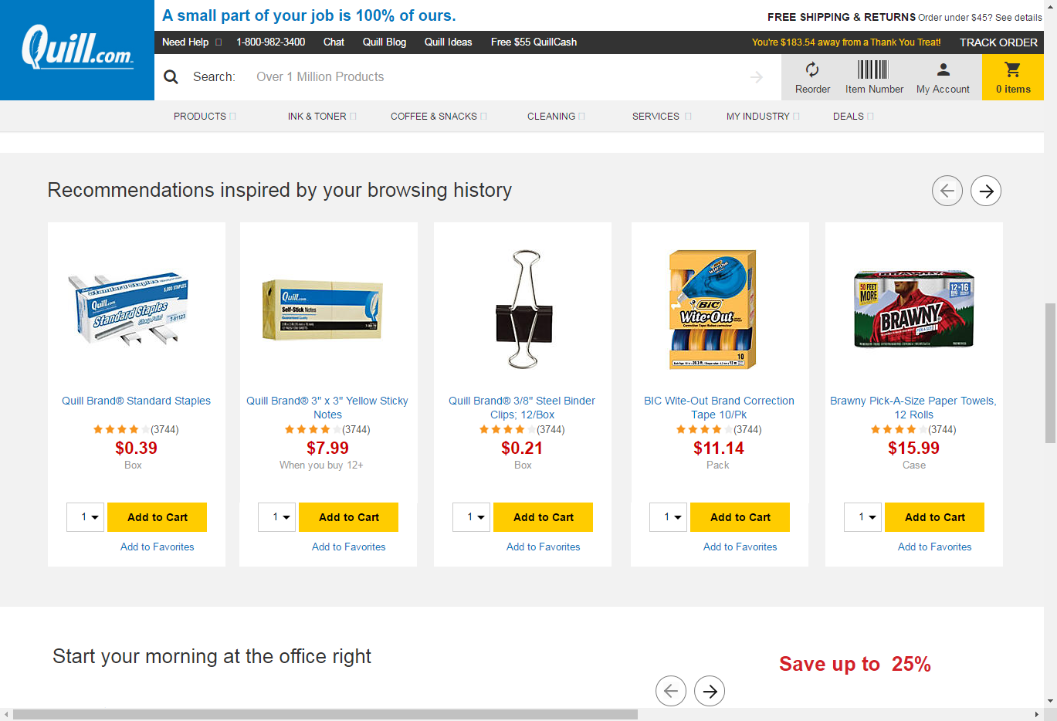
Findings – Homepage
1 user invasive / “turned off”

Slide 7
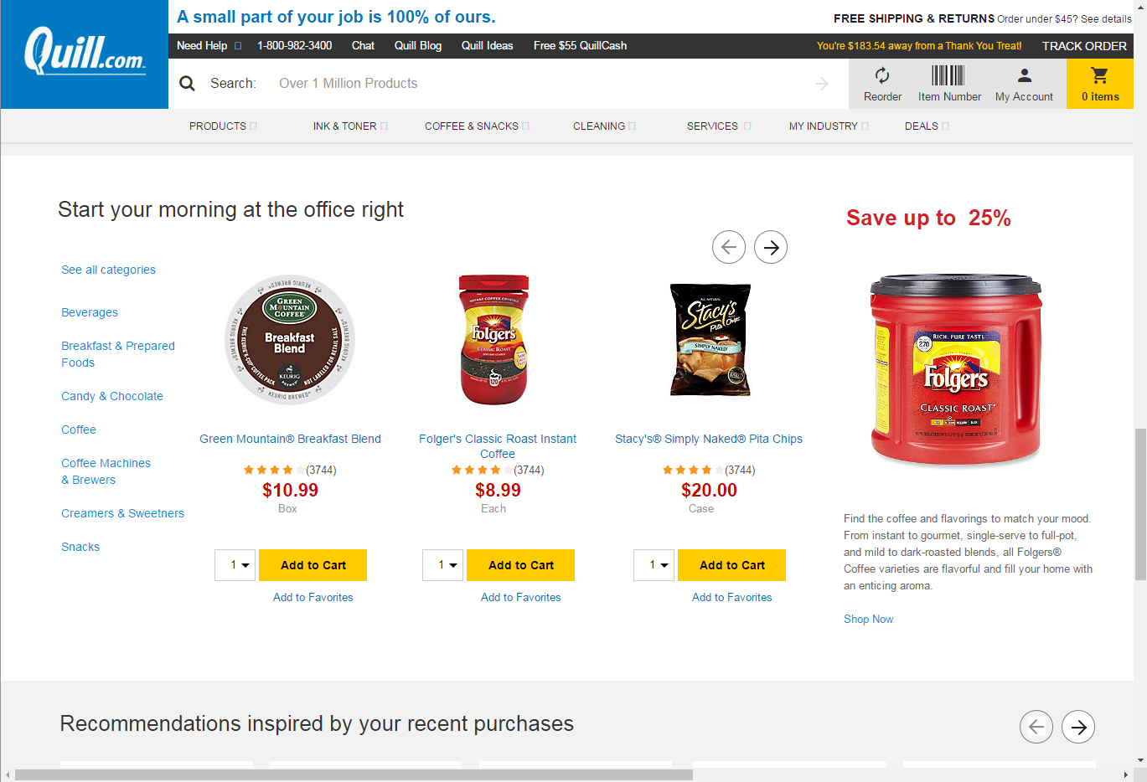
Findings – Homepage
3/12 Ribbon titles not standing out
2/12 not understanding ribbon titles, purpose
7/12 users understood groupings

Slide 8
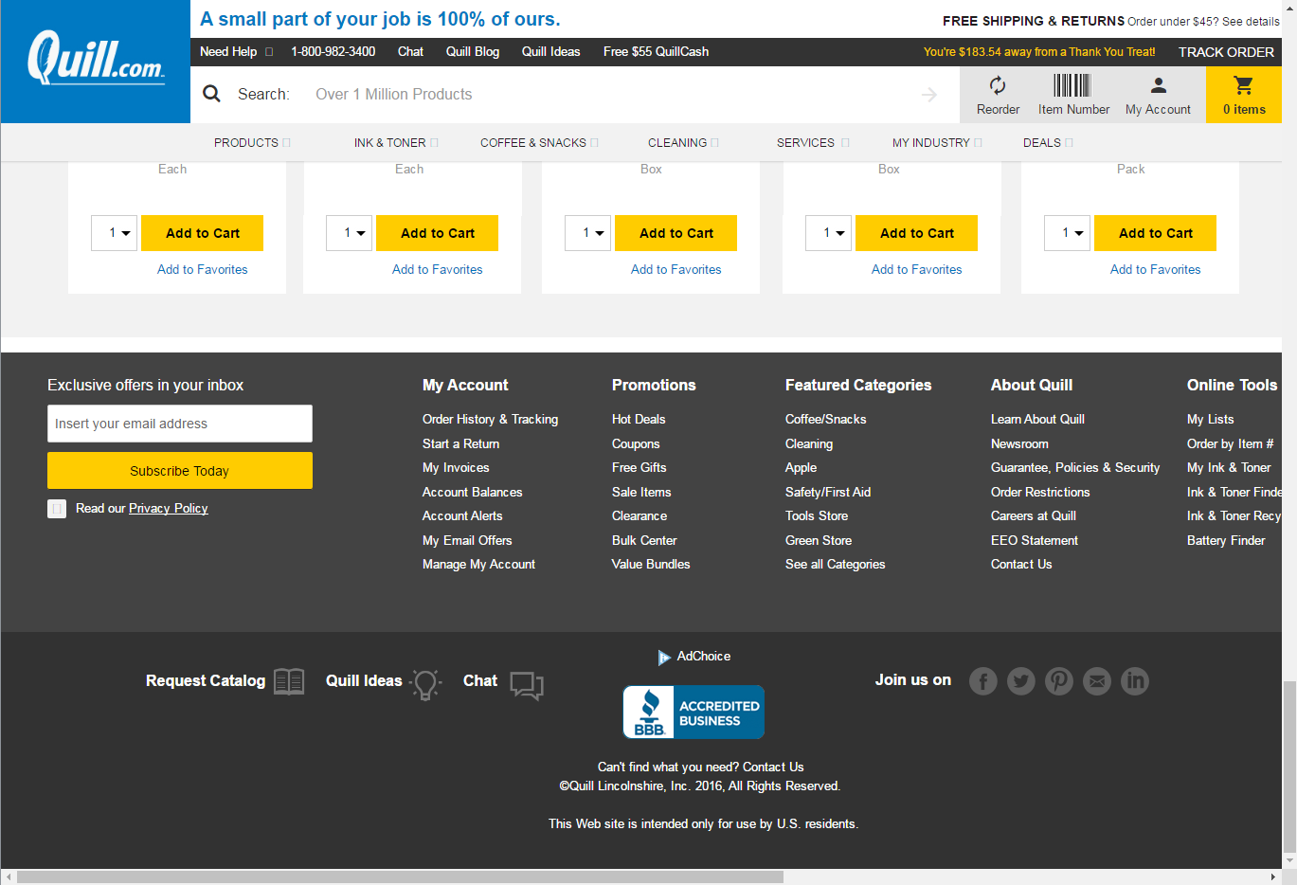
Findings – Homepage
4/12 good

Slide 9
Findings - Type-ahead
Findings - Type-ahead
4/12 trouble finding search bar

Slide 10
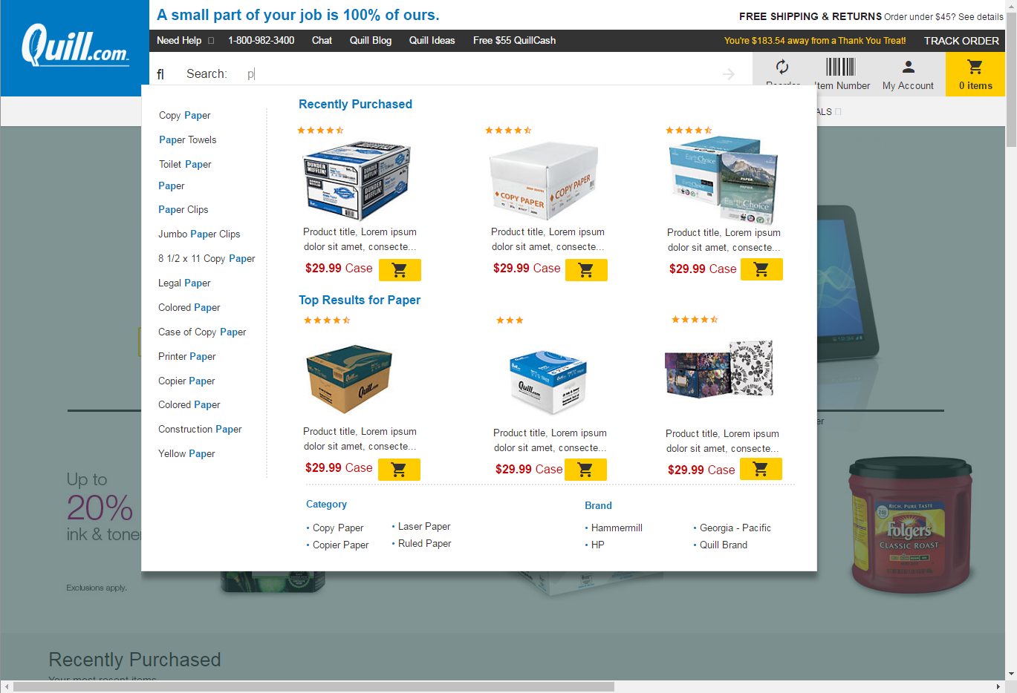
Findings - Type-ahead
12/12 preferred
6/12 liked the :on hover functionality of the left categories
"oh, fancy I like that,” 2 users specifically referred to immediate FB
No ability to change quantity
8/12 easily found the add to cart button, 1 user preferred on page feedback

Slide 11
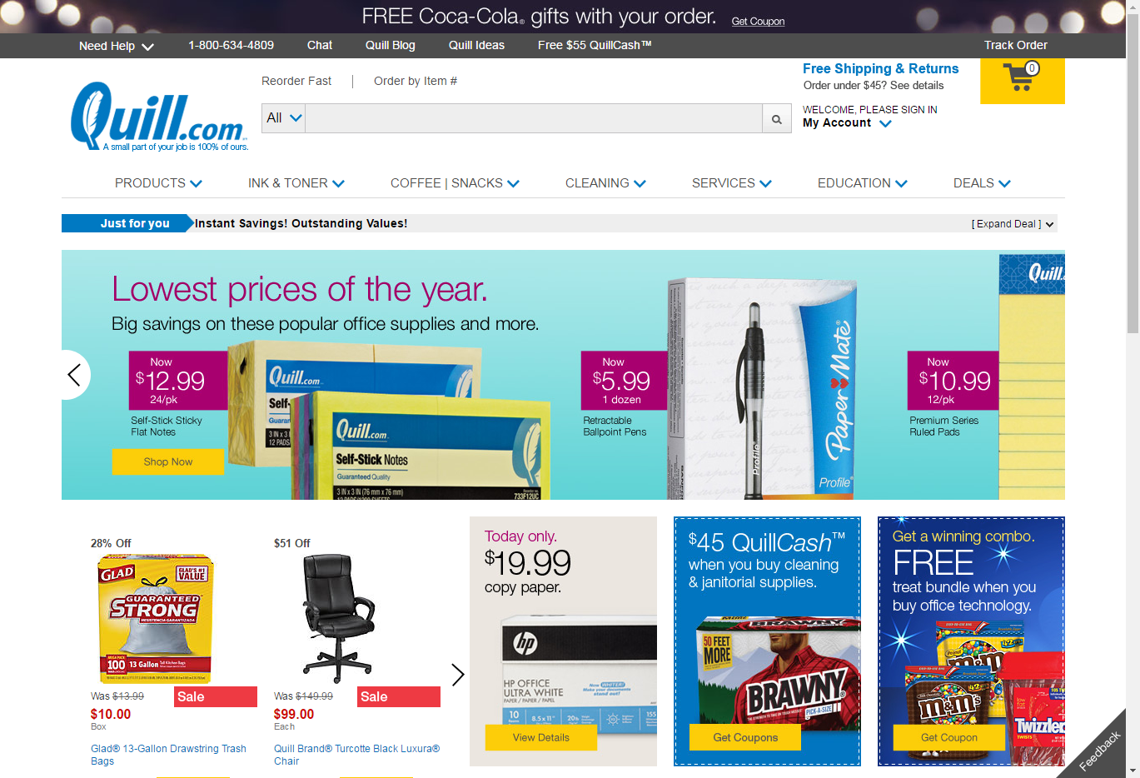
Findings - Compare
Findings - Compare
“more simple”
production more complex and distracting
12/12 Prefer new design
One user prefers how to log in to access account on production
Visual simplicity
production is busy, "scattered, jarring, not crazy about banner"

Slide 12
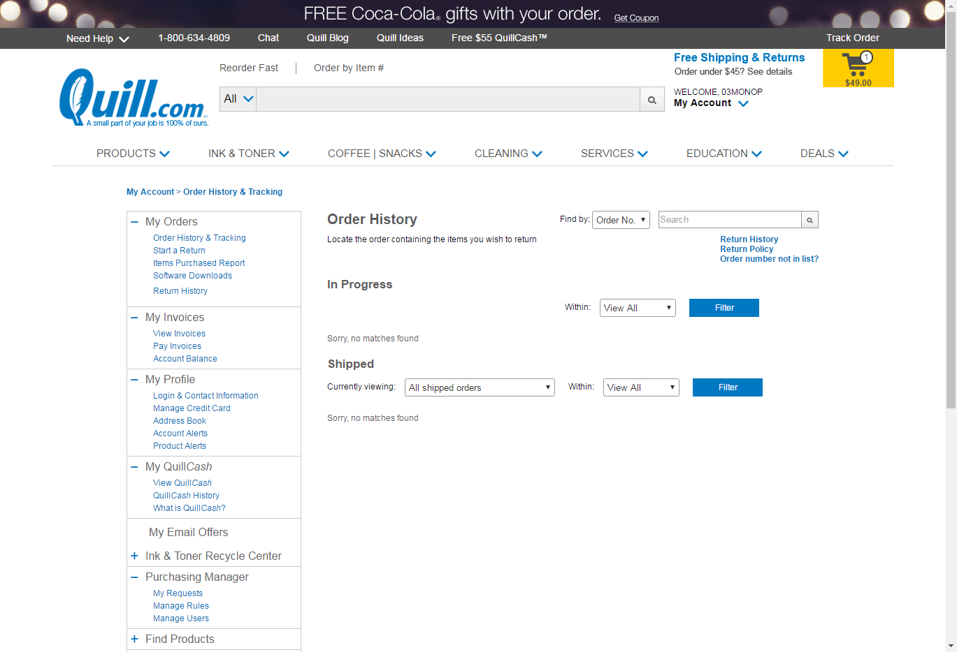
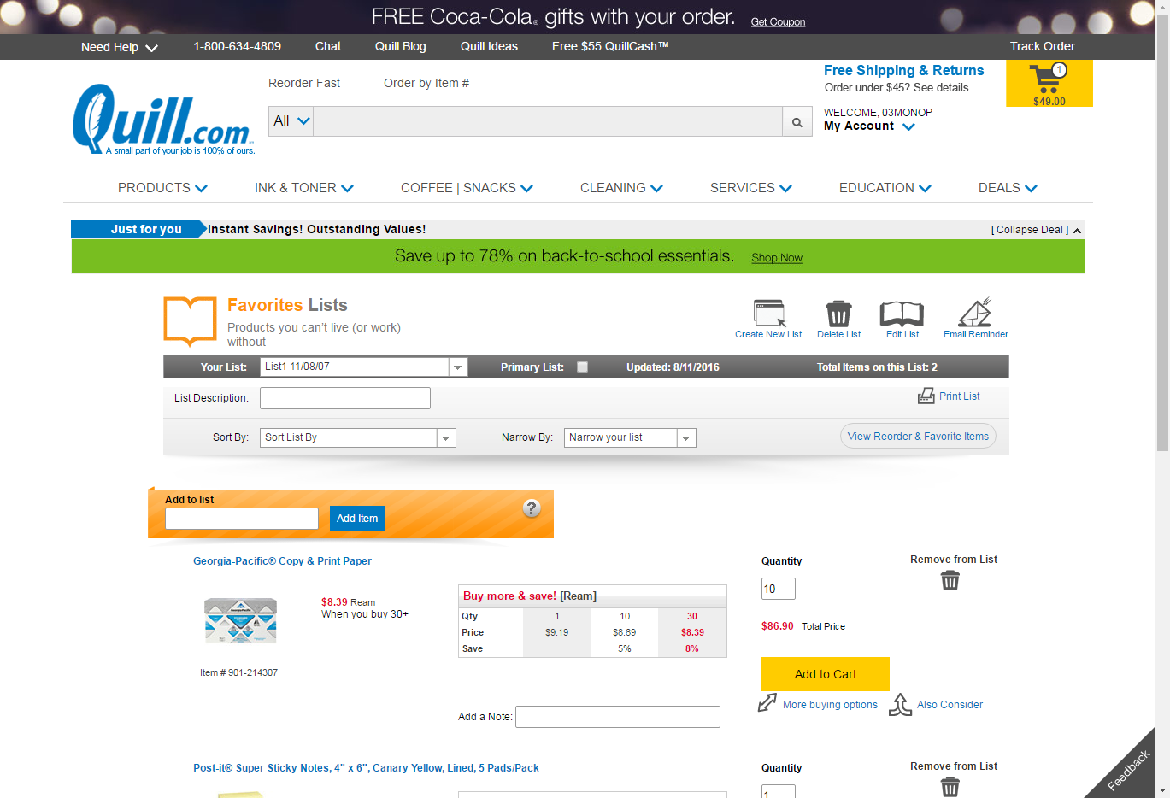
Findings – Compare (Lists)
would like to create her own lists, didn't know where to go
uses order history today, not great
didn't know about lists

Slide 13
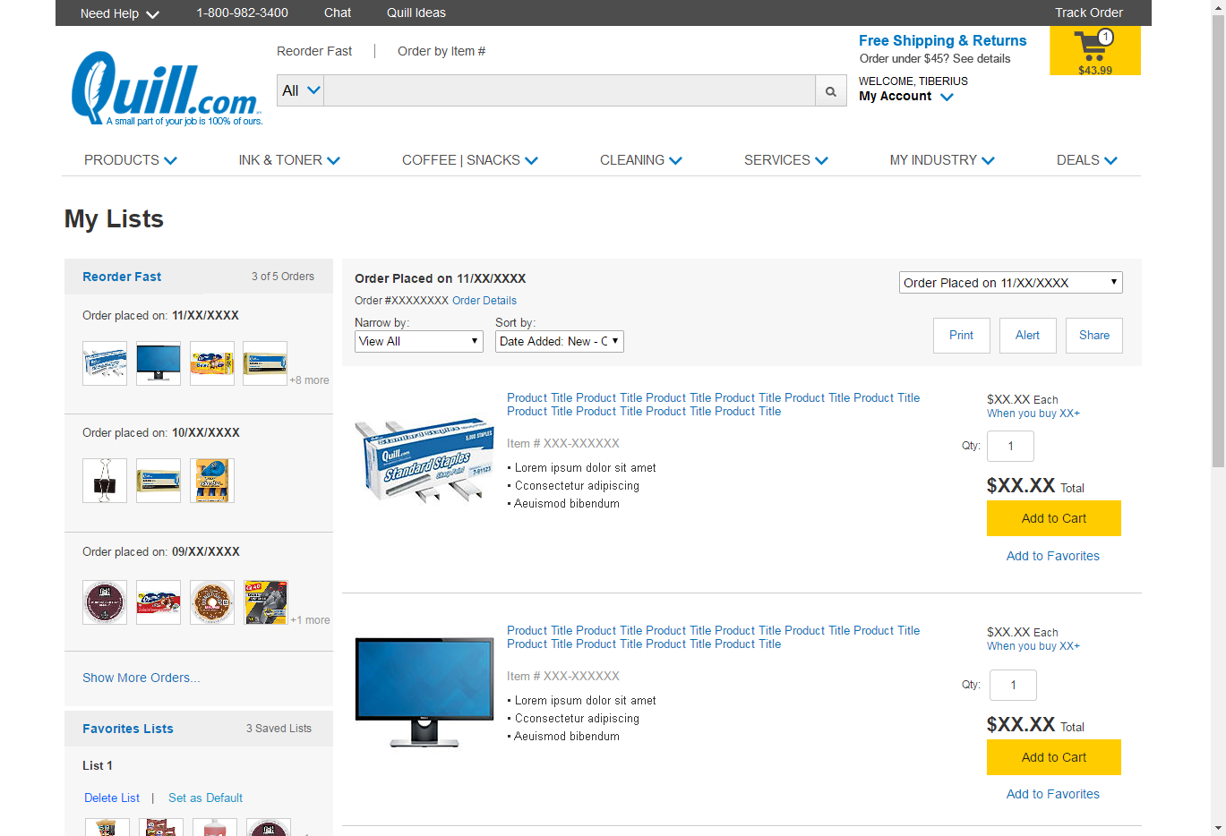
Findings - Lists
Findings - Lists
“would be so much easier”
7/12 knew nothing about current lists functionality, or don’t use
12/12 Prefer new design

Slide 14
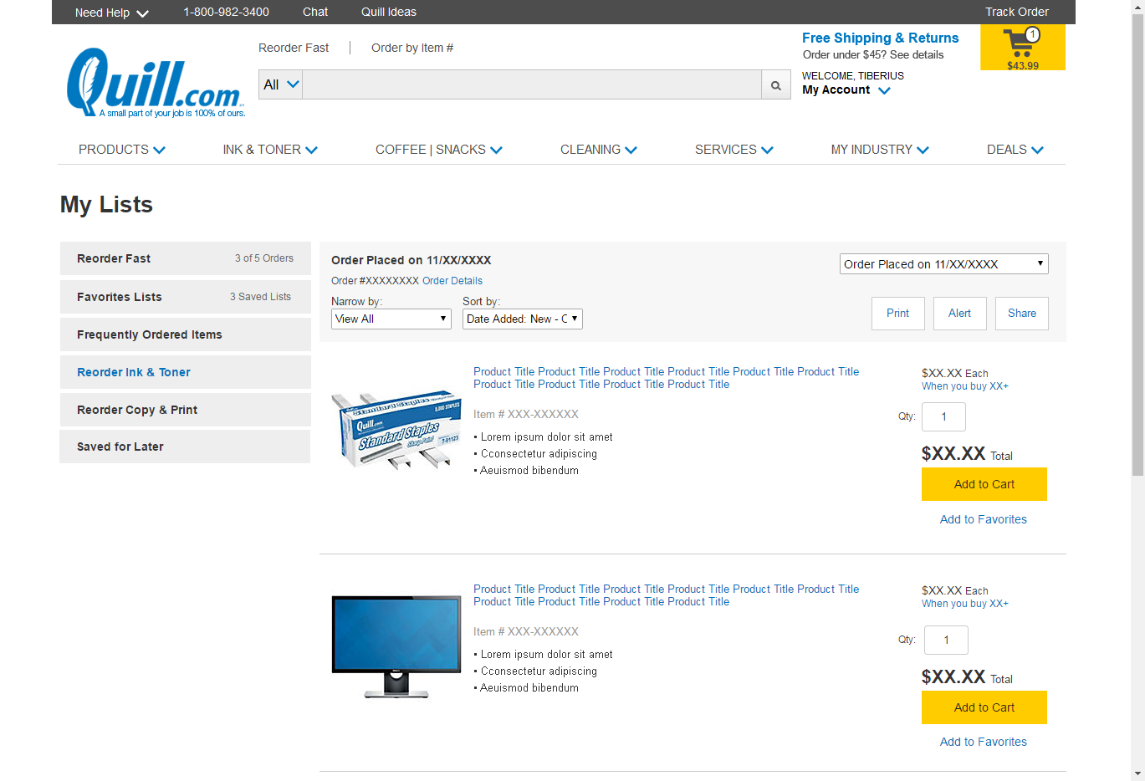
Findings - Lists
"bam you order these things all the time, here you go"
Reorder, set defaults, max/min
More prominent, different color

Slide 15
Findings - Punchcard
Positives
8/12 users mentioned it favorably,
7/12 mentioned quill keeping track "as long as you keep track of it"
Options, buy 10 get 11th free, buy 10 in one category get another item free, 100$ = 10 pts 100 pts to get free item, buy items in different categories (gamify)
Negatives
"I ain't got time for that $h!7"
Gimicky
Prefers rewards over punchcards
Prefers QC

Slide 16
Findings - General
Overall the updated homepage was received well. All users preferred the redesigned page.
Even though there is more information on the page, users mentioned how clean and simple it was.
Overwhelmingly, users mentioned only using the top section of the site, to search or reorder, not browsing the entire page.
Several users mentioned the titles of the ribbons and the top bar navigation not standing out. Most users understood the groupings of the ribbons.
Users overwhelmingly liked the new functionality, and appreciated the visual feedback.
Add to cart from search was intuitive, 8/12 users used this function 2 more recognized it, but still would go to SKU page.
All users preferred the new layout for lists, 7/12 users did not know or didn’t want to use lists, but after seeing the new version said they would use.
Punchcards, Overall received positively, as long as the user doesn’t have to do any extra work.

Slide 17
Findings – Other
wording of browsing history is invasive, turns me off
more likely to look at type ahead results, mean more than homepage
landing page should say, we have everything, more than office supplies
Regarding punchcard ideas free item, choice of new products more likely to order from quill again

Slide 18
Recommendations
More visibility on my account and how to log in should be established on the new design.
Make ribbon titles more prominent.
Refine search bar (in progress)
On type-ahead, There should be a change of quantity option.
On lists, The accordion should be customizable and made more prominent.
On type-ahead, make it clear how to get to full search results.
A/B test new design against Production.
Create a Punchcard design concept

Slide 19
Next Steps
More research should be done regarding on page add to cart feedback vs opening a new page.
More research on helping users discover functions of the site
Create cleaner unifying design for add to cart confirmation
Analyze the Quill Business Homepage A/B test results and refine designs as needed
Start customer journey map for a possible punchcard
Enhance the List design and update stories for 2017

